Slide 1

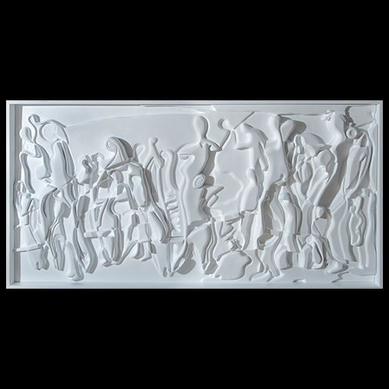
Música creada
Imagen de entrada
Interpretación de la IA
a white plaster sculpture of people and letters on a black background, with a black background and a white background, an abstract sculpture, figurativism

Slide 2


a woman with red hair is smiling and holding a cigarette in her hand and pointing to the side of her face, Chinwe Chukwuogo-Roy, facial muscles, a stock photo, figurativism.
Audio 1
a man standing in front of a carnival ride at night time with a smile on his face and a green shirt on, David Boyd, f 1. 8, a stock photo, cloisonnism
Audio 2

Slide 3
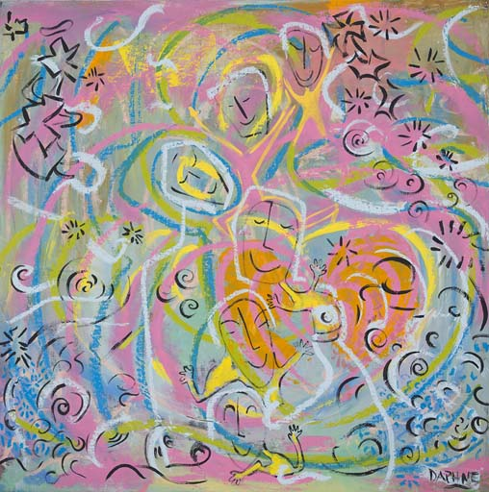
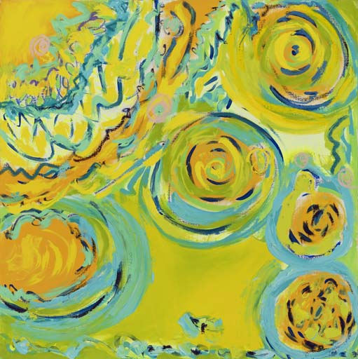
a painting with many different colors and shapes on it's surface, including a pink background and a yellow background, neo - expressionism, an ultrafine detailed painting, neo-expressionism
Audio 2
a painting of yellow and blue circles on a green background with a white border and a yellow background with a white border, neo - expressionism, an abstract painting, lyrical abstraction
Audio 3

Slide 4
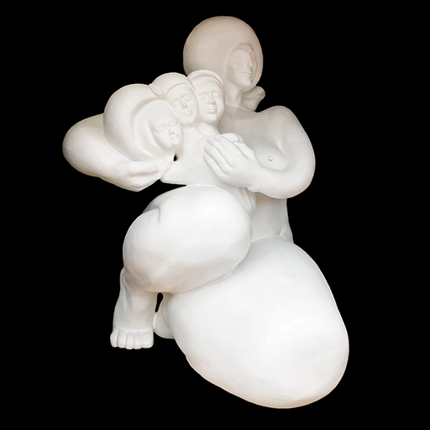
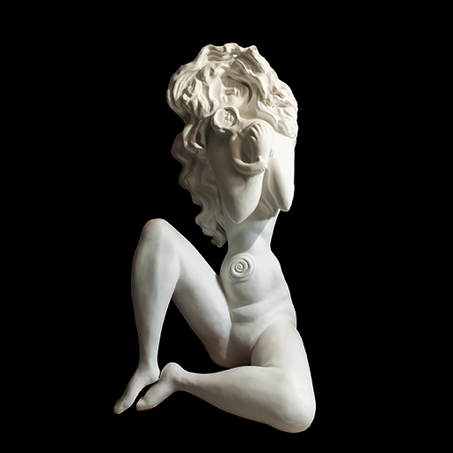
Audio Madonna
a white sculpture of a woman holding a baby in her arms on a black background with a black background, sculpture, a marble sculpture, figurativism
a white statue of a woman with her legs crossed and her hand on her hips, sitting on a black background, sculpture, a marble sculpture, figurative art
Audio Ternura

